Slide 1

Hackathon 2019
Tech Fiesta 2019 Presents
Hari Kantipudi
Gayatri Kandula
Nitin Rajora
Pallav Kumar
Kishan Sanghani

Slide 2

Problem Statement
And the winner of Cricket World Cup 2019 is?
The most awaited season of Cricket is coming soon. Cricket World Cup 2019. Keeping in mind that there are sportsmen who are showing their best performances in the recent tournaments like IPL this has increased the expectations on the players as well as the Team. Considering all the points, predict the Winners of ICC Cricket World Cup 2019.
Following Information regarding the players and teams will be provided in the data-sets:
Player profile (like batting/bowling stats, team they belong to etc.)
Team match results for past 15 years

Slide 3
Explain your approach/business flow to the solution
Preliminary Data Preparation and Exploratory
Random Forests – Ensemble Model Building
Business Understanding
Data Analysis
Data Preparation for model building
Model Evaluation

Slide 4
Technologies Used

Slide 5
Solution
Conclusion and Predictions

Slide 6





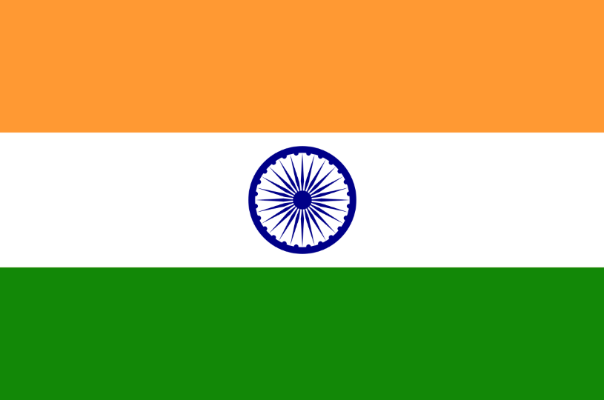




Q & A

